Slide 1

Customer Churn Prediction - using ANN

Slide 2
Team Members:
Vyshnavi Bussa -700757313
Jayadeep Nagubathula -700747518
Manaswini Kandula -700742610
Manikanta Balineni -700748426

Slide 3
Roles and Responsibilities:
Manaswini worked on identifying the necessary papers, data selection and basic coding for the project implementation.
Manikanta worked on dataset collection based on the column names required for the project, and tested different epoch values.
Jayadeep worked on coding for implementing the dataset by importing, training, and testing values.
Vyshnavi worked on the code, documentation and presentation of what we have done.

Slide 4

Motivation:
The main motivation of Churn prediction is to detect which customers are likely to leave a service or cancel a subscription to a service.
This provides businesses with a proactive approach to identify customers who are at a high risk of churning. So, that allows them to take timely actions to retain customer churn.
Resource optimization is used to predict the user by prioritizing churn prediction by allocating market budgets, customer service efforts and product improvements.
Gaining competitive advantage by allowing them to proactively address customer churn. By outperforming their competitors.

Slide 5


Objective:
Primary objective of the customer churn predictive model is to retain customers at the highest risk of churn by proactively engaging with them.
Early Identification of churn this allows businesses to take proactive measures to retain these customers, by offering personalised offers, target promotions or by improving customer service.
And also finding target columns, extracting the right feature extraction.

Slide 6
Related work:
One of the papers compared the performance of different ANNs and ensemble methods for customer churn prediction in the telecommunications industry. The authors evaluated various feature selection techniques and model selection strategies to optimize the ANN model's accuracy and generalization performance.
Others proposed the use of deep neural networks, specifically stacked autoencoders, for customer churn prediction in the presence of imbalanced data.
One research compared the performance of different recurrent neural networks, including Long Short-Term Memory (LSTM) and Gated Recurrent Unit (GRU), for customer churn prediction in subscription services.
One of the studies applied convolutional neural networks (CNNs) for customer churn prediction in the e-commerce domain. The authors utilized CNNs to automatically learn features from customer transaction data and achieved competitive prediction accuracy compared to other methods.

Slide 7
Problem Statement:
Customer churn, also known as customer attrition, is a critical issue for businesses, especially those in highly competitive industries.
Predicting customer churn can help businesses proactively identify customers who are likely to stop using their products or services, allowing them to take timely action to retain those customers and minimize revenue loss.
Artificial Neural Networks (ANN) is a popular machine learning technique that can be used for customer churn prediction due to their ability to model complex relationships in data.
The problem statement for customer churn prediction using ANN would involve addressing these challenges to build an accurate and interpretable model that can effectively predict customer churn in real-time, enabling businesses.

Slide 8

Proposed Solution:
ANNs are a type of deep learning model that can be used to make predictions based on patterns learned from large datasets.
Retrieve data from online sources such as Kaggle. Gather a labelled dataset that includes features and corresponding churn labels.
Define the architecture of your ANN. In this, we define the number of layers and epochs. This includes specifying the number of layers, the type of activation functions, and the number of neurons in each layer.
Experiment with different architectures to find the one that performs best for your specific dataset.

Slide 9
Proposed Solution:
Compile your ANN by specifying the optimizer, loss function, and evaluation metrics. The optimizer is used to optimize the model weights during training, and common choices include stochastic gradient descent (SGD), Adam, and RMSprop.
Train your ANN using the training dataset which we divided earlier as per the ratio. During training, the model adjusts its weights iteratively to minimize the loss function.
Evaluate your trained ANN on the testing set to assess its generalization performance. Calculate various evaluation metrics to determine how well the model is performing in terms of churn prediction accuracy.
Continuously monitor the performance of your churn prediction model in production to detect any potential degradation in performance.

Slide 10
Results:
Depending on the dataset and model complexity, an ANN can achieve an accuracy ranging from 80% to 95% or higher.
We altered the dropout rate and found that the accuracy of our Ann model with 0.1 loss and 100 epochs is 85.3 % whereas 0.6 dropout rate is 84.3% .
Most of the customers are from France but most customers who churned are from Germany
The proportion of male customers churning is also greater than that of female customers.

Slide 11
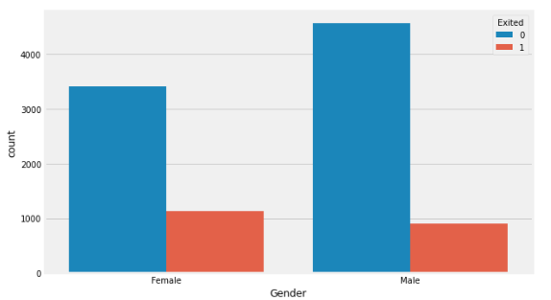
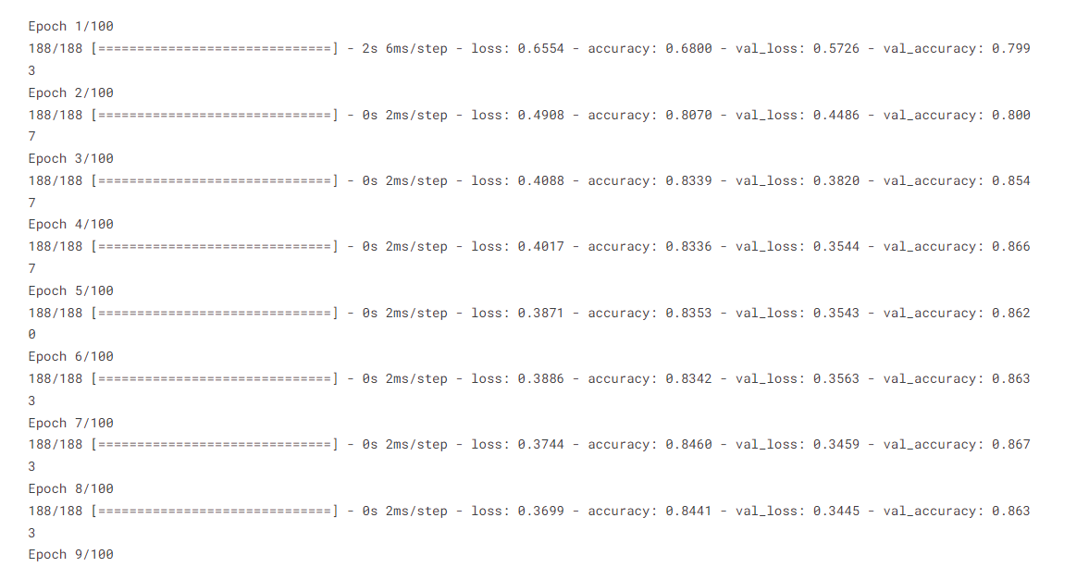

Slide 12
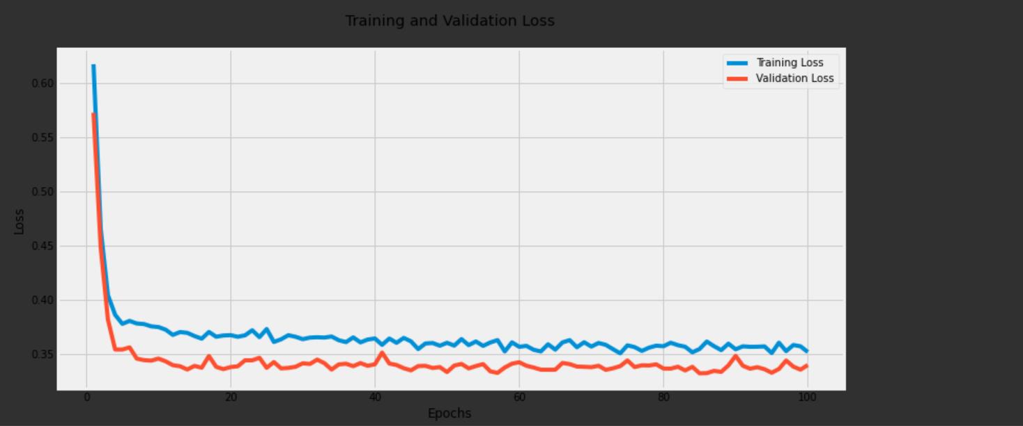
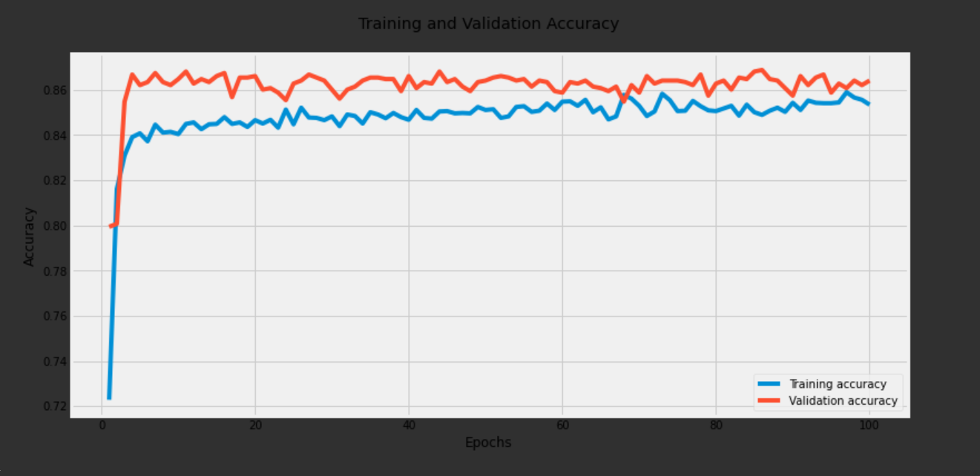
(iii)Training and Validation Loss
(ii)Training and validation Accuracy

Slide 13
References:
Nguyen, T. H., Nguyen, C. D., Ho, B. Q., & Nguyen, L. M. (2019). Churn prediction in telecom industry using deep learning with the help of big data. Journal of Big Data, 6(1), 34.
Ruokolainen, L., Rinta-Tepponen, J., & Kukkonen, S. (2019). Deep learning for customer churn prediction in the telecom industry: A comparative study. Expert Systems with Applications, 135, 262-274.
Karim, A., & Hossain, M. S. (2020). Customer churn prediction in telecom industry using deep learning techniques. International Journal of Computer Science and Network Security, 20(1), 10-16.

